Slide 1

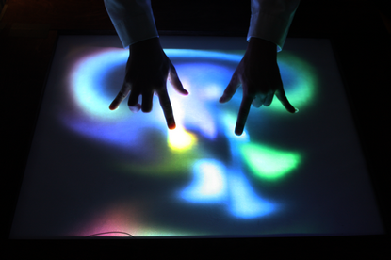
MULTITOUCH POLYGON
MORPHING
MULTITOUCH POLYGON
MORPHING

